Slide 1
Time Series II
FB Prophet and LSTM
Arunabh Singh

Slide 2
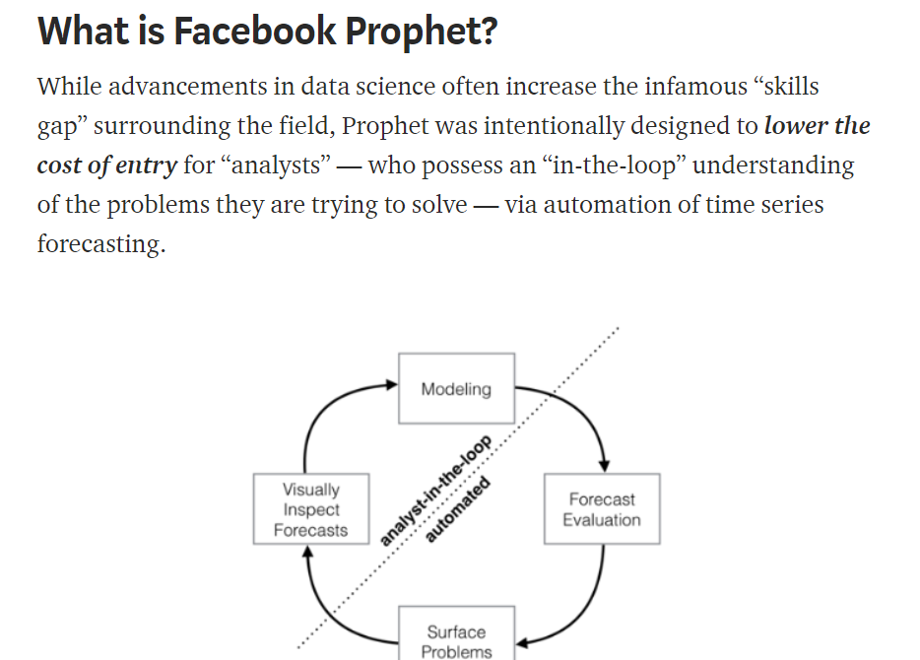
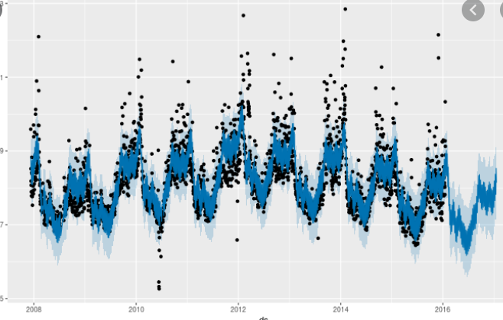
FB Prophet

Slide 3
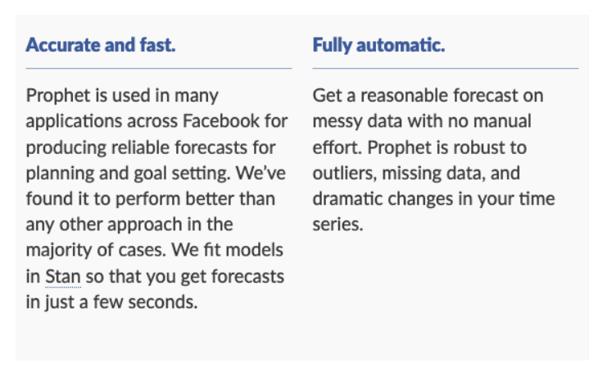
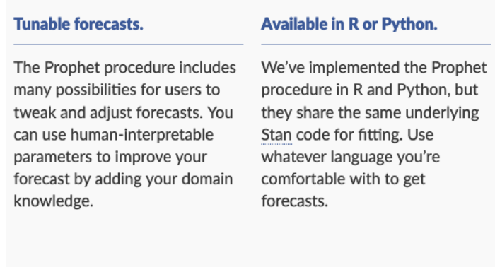
Why is it useful
Prophet is a procedure for forecasting time series data based on an additive model where non-linear trends are fit with yearly, weekly, and daily seasonality, plus holiday effects.
It works best with time series that have strong seasonal effects and several seasons of historical data. Prophet is robust to missing data and shifts in the trend, and typically handles outliers well.

Slide 4
How Prophet Works ?
The procedure makes use of a decomposable time series model with three main model components: trend, seasonality, and holidays.
y(t) = g(t) + s(t) + h(t) + e(t)
g(t)
trend models non-periodic changes; linear or logistic
s(t)
seasonality represents periodic changes; i.e. weekly, monthly, yearly
h(t)
ties in effects of holidays; on potentially irregular schedules ≥ 1 day(s)
y(t) = g(t) + s(t) + h(t) + e(t)
g(t)
trend models non-periodic changes; linear or logistic
s(t)
seasonality represents periodic changes; i.e. weekly, monthly, yearly
h(t)
ties in effects of holidays; on potentially irregular schedules ≥ 1 day(s)
The error term e(t) represents any idiosyncratic changes which are not accommodated by the model
Prophet fits several linear and non-linear functions of time as components.

Slide 5
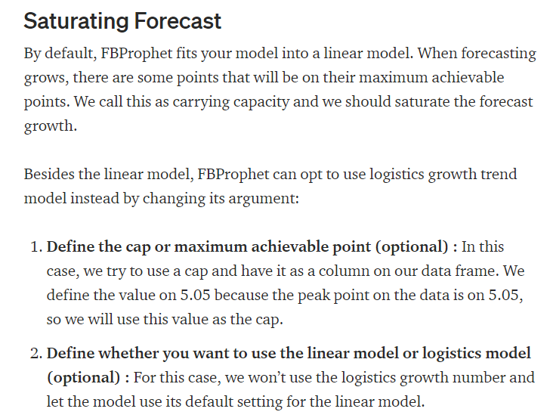

Slide 6
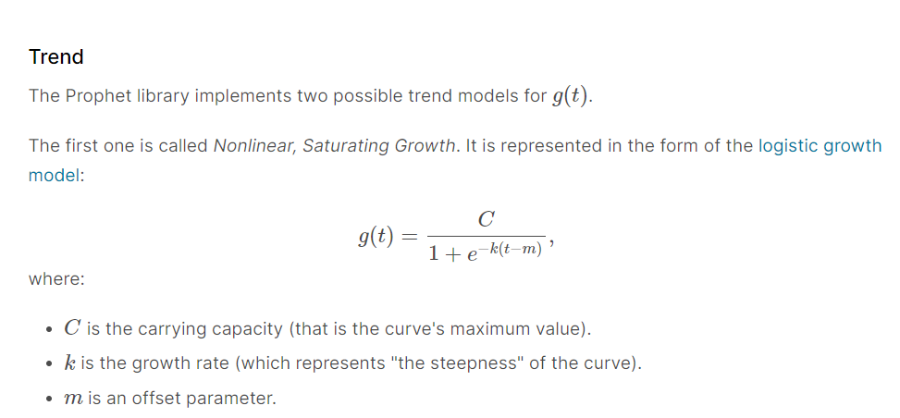
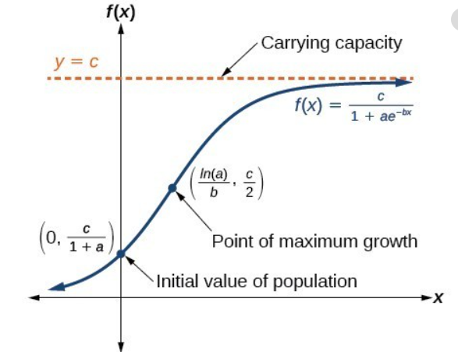
Trend determined by Prophet

Slide 7
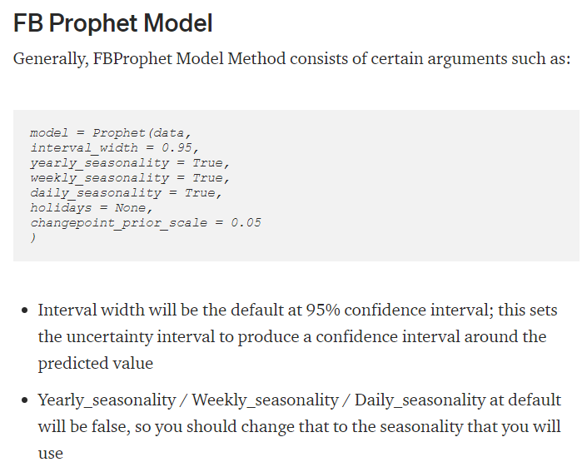

Slide 8
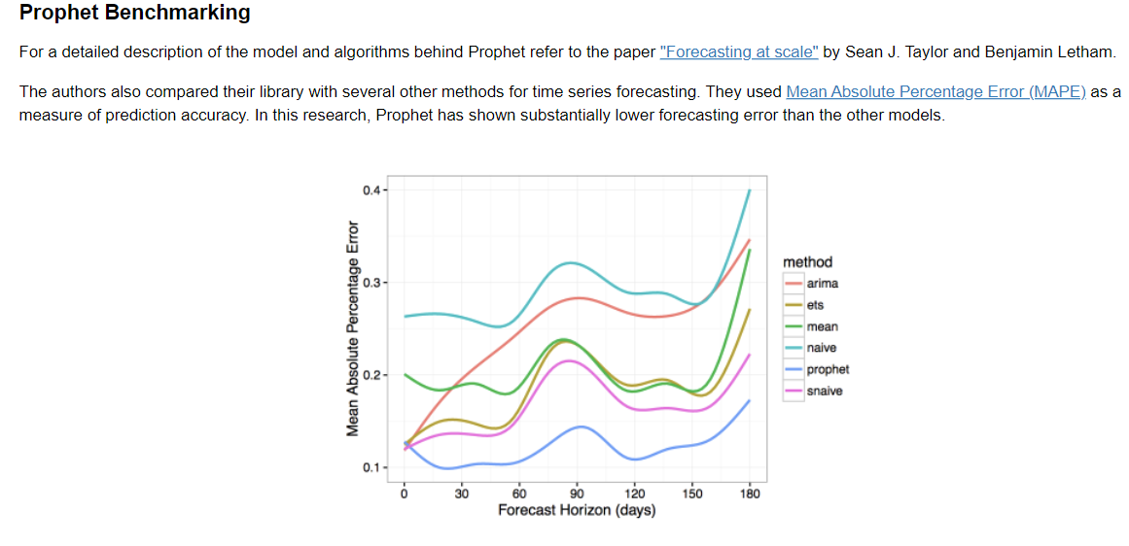

Slide 9
